Slide 1
New Potable Water Pipeline Lining Technologies
NZ Land Development Forum
Keith J Woolley
Chief Advisor Potable water

Slide 2
Presentation
1. Wellington water potable water system
2. Potable water assets
3. New Potable Water Pipeline Lining Technologies
Notes:
Objectives
Reflect on resilience
Reflect on standards we have adopted
Not included
Future planning and prioritisation for individual Councils is the subject of a regional seismic resilience project being carried out to input into the next LTP.

Slide 3
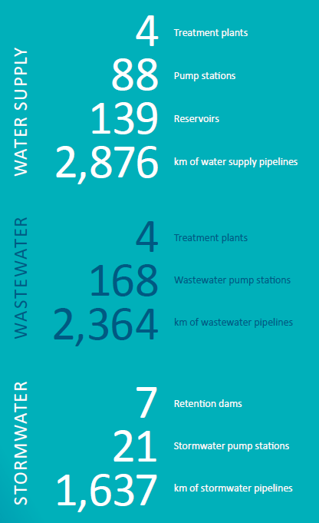
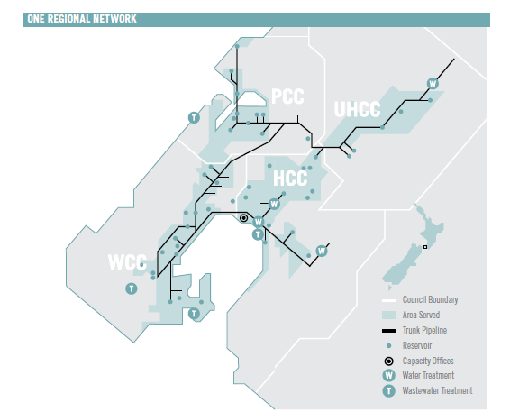
Three waters in the metro region
Notes:
Wellington water formed 2 years ago…..CCO
5 Councils…………………..400,000
3 waters
3000km of water pipes
140 reservoirs
USE NEXT SLIDE for supply

Slide 4
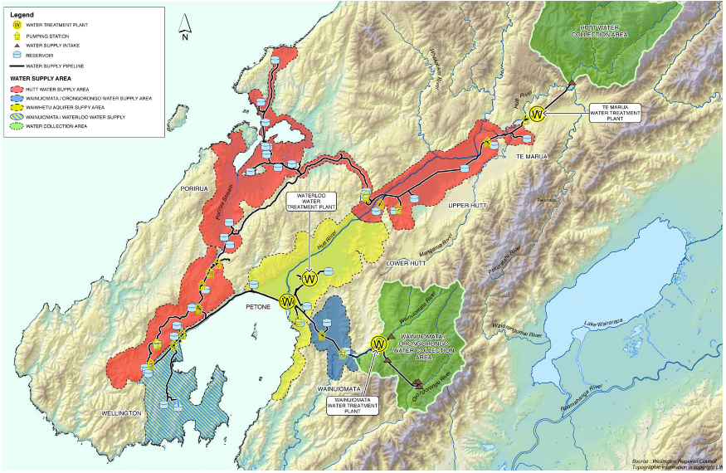
Notes:
4 water treatment plants
Te Marua WTP- ornage/red
surface water from Hutt river, direct filtration /clarifier
100/140MLD 60%
Waterloo- yellow
up to 115MLD from 8 bores across Hutt Valley- Queensgate Mall to Waterloo rail interchange- 30/70%
pH correct/unchlorinated
Gear Island –
Wainuiomata- blue
60MLD DAF plant gravity supply to Wellington and Wainuiomata (Hutt)

Slide 5
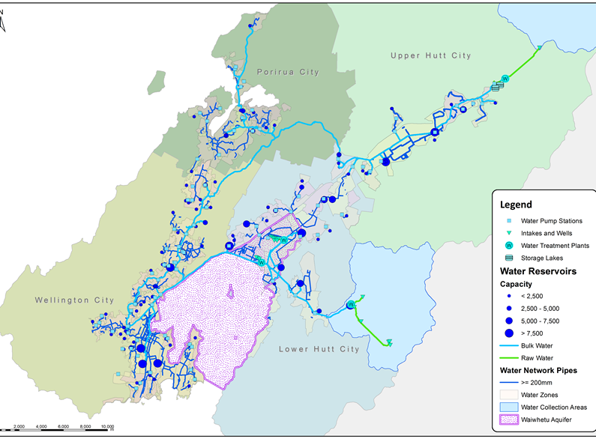

Slide 6
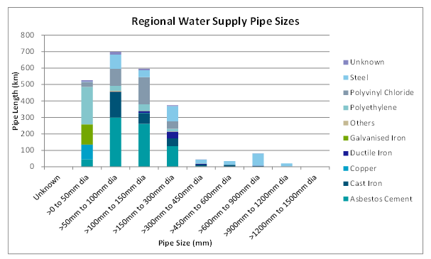
Pipe materials

Slide 8
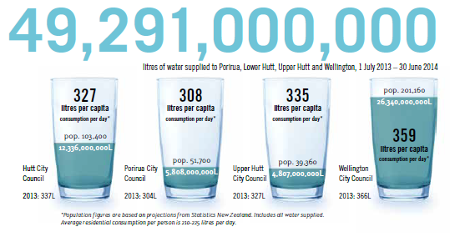
Water supply
Notes:
Supply
50,000 million litres/year
220 litres/head domestic
340l/hd/day gross
130ML/day

Slide 9
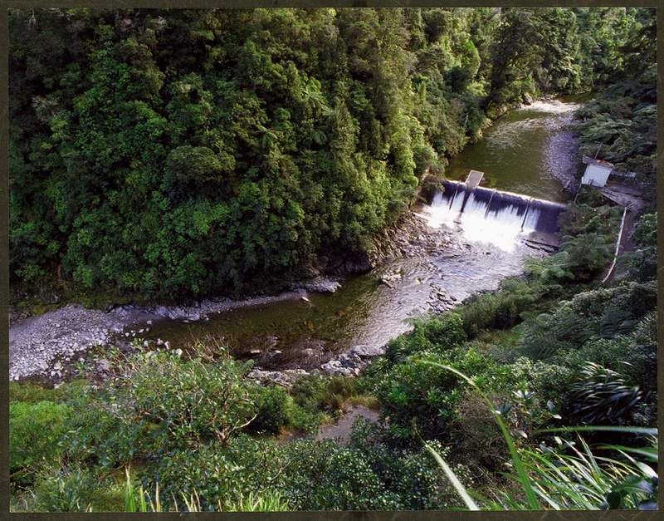
Where does our water come from?
Rivers…
Notes:
60% of our water comes from rivers

Slide 10
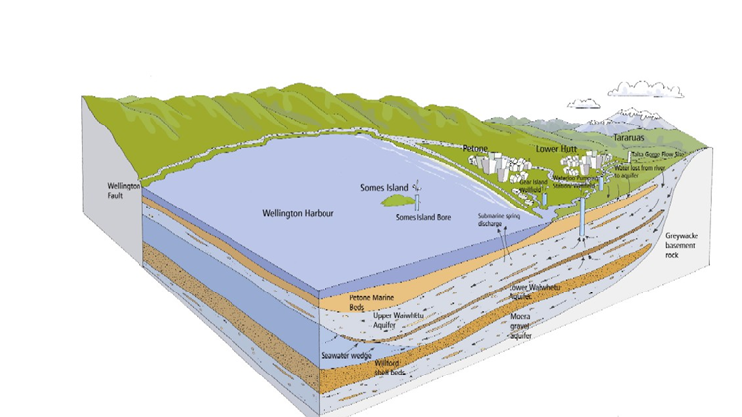
Aquifer
Notes:
40% of our water comes from the Waiwhetu Aquifer
From Taita Gorge to harbour mouth
Naturally pressurised (artesian) from Melling
70 m. thick at western edge to 20 m. at east
Secure’ source
Naturally safe
8 wells near Waterloo
3 wells at Gear Island

Slide 11
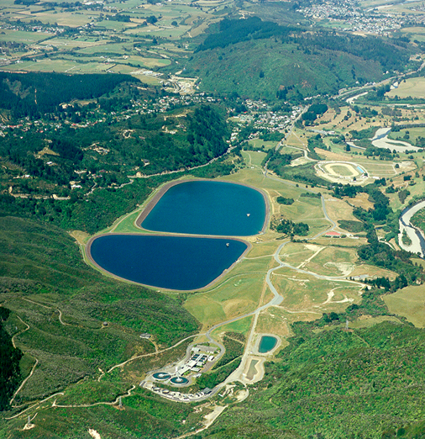
Te Marua water treatment plant
Notes:
Design capacity 140 ML/d
Production average 60 ML/d
40% of annual supply
‘A1’ grading
3600 ML off-river storage
Built 1980-1987

Slide 12
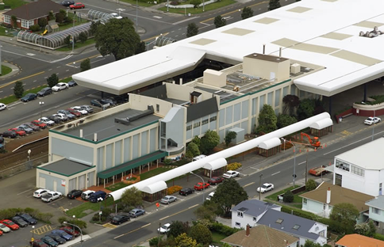
Waterloo water treatment plant
Notes:
Design capacity 115 ML/d
Production 60 ML/d
40% of supply
‘B’ grading
Built 1981

Slide 13
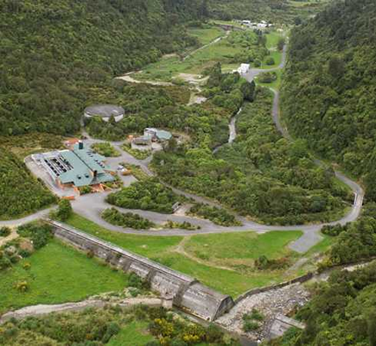
Wainui water treatment plant
Notes:
Design capacity 60 ML/d
Production 30 ML/d
20% of supply
‘A1’ grading
Built 1993

Slide 14
Why new technologies?
Growing asset age
Smart renewals are needed
Seismic resilient system; 80-30-80
Take into account customer, road and maintaining LoS
Limited funding

Slide 15
Project
Our panel (GHD) carried out the research
GHD global offices, on-line and suppliers
Intention of a world wide search
Satisfy WWL performance requirements; RSWS

Slide 16
New potable water lining systems
Very few found
Fall into four categories;
CIPP liners
Non-structural liners
Close-fit liners
Slip liners

Slide 17
Study considerations
Residual parent pipe seismic resilience
NZ availability
NZ contractor availability
Time to install and cure
Temperature limitations
Overseas trends
Cost, risk and Health and Safety

Slide 18
Behaviour during extension

Slide 19
Behaviour during compression

Slide 20
Conclusions
Non- structural liners are not used
Close fit liners in non- continuous host pipes are not used
Swage lining fully welded bulk pipes be used (not in reticulation with connections)
Slip lining water mains with butt welded PE structural liners
More study into butt welded PVC pipe liner
Notes:
Non structural liners- CIPP (no ductility/ strong bond to host pipe) is not used, thin walled PE
Close fit PVC liners (Duraliner) and butt welded PE lining systems in non-continuous pipelines
Swage liners need to cut back host pipe and reduce its strength as well as high chance of dame of the swaged pipe.
Swage lining- PE is drawn through a die to temporarily reduce its lining- high pipe and lining friction.
Slip liners are isolated from the lining and host pipe
Butt welded PVC pipe to slip line water mains e.g. notch sensitivity

Slide 21
Next step
Keep eye open for new products
Target products for further investigation:
Close fit oriented PVC liner
Sprayed poly-urea liner

Slide 22
Contact:
keith.woolley@wellingtonwater.co.nz

