Slide 1
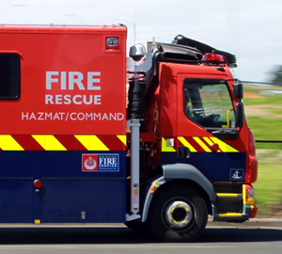
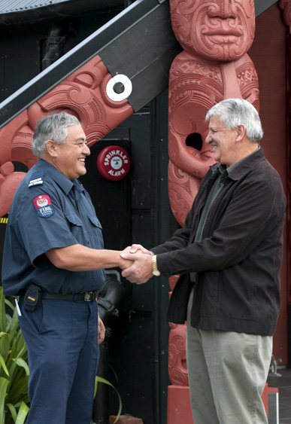
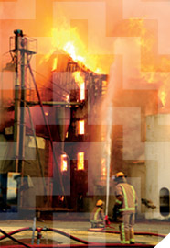
Firefighting Water
Land Development Engineers Forum 16th March 2017
Ian Duncan
National Advisor Fire Risk Management

Slide 2
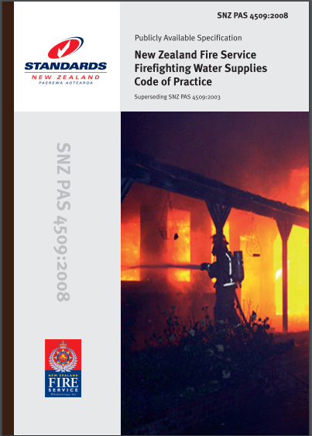
Firefighting Water
Why is water important?
How do we use it?
How do we get it?
Challenges
Code of Practice.
Notes:
We will look at:
Why water is important to the fire service
how the fire service uses water,
how we get it, and
some of the challenges we face in getting it to where we need it, and
the CoP for firefighting water supplies which aims to provide structure around addressing the issues we face.

Slide 3
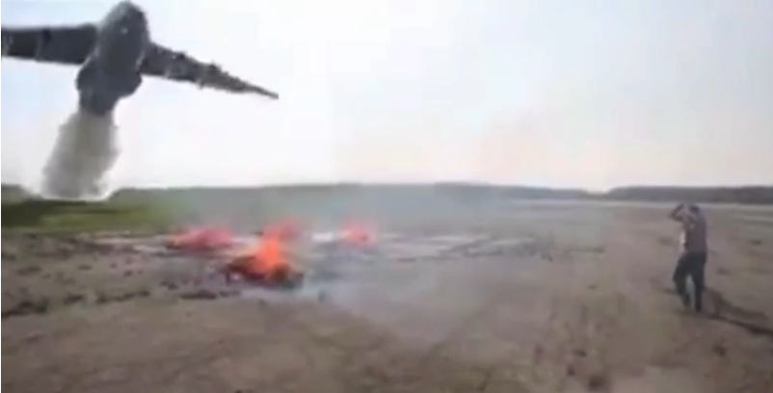
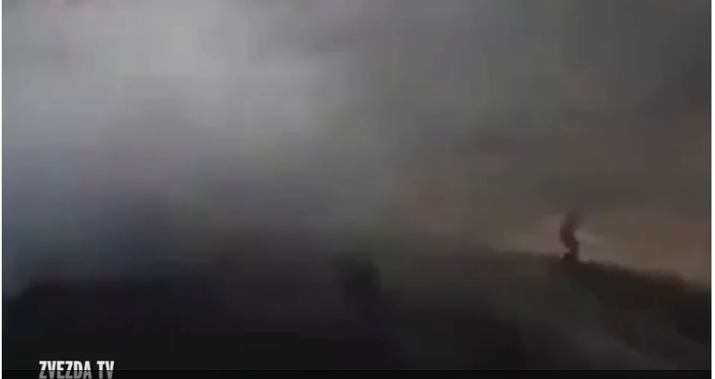
Why is Water important?
Best for majority of fires
Cheap
Readily available
Easily transported & delivered
Large heat capacity.
Notes:
Best for the majority of the fires we deal with. Most fires are carbonaceous in nature
Cheap when compared to foams, CO2, N2, etc.
Readily available- for the most part. Comparing drought conditions in parts of Canterbury with the recent floods in Northland shows that it is not always where you want it!
Easily transported & delivered- it is formless which allows it to be transported in any container. Very handy for helicopter attacks via monsoon buckets (1,500 litres at a time)
Large heat capacity means it absorbs vast amount of heat- 4,180 J/Kg ⁰C. (This is the second highest for a natural product behind ammonia!)
Perhaps we don’t need to use this much, in this way, on this small a fire every time however….
http://www.mirror.co.uk/news/world-news/air-tanker-soaks-bystanders-near-8190192
(10-20,000 gallons)

Slide 4
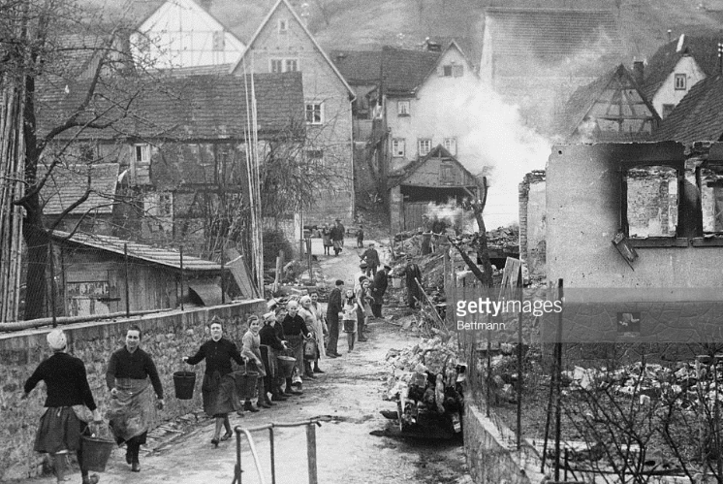
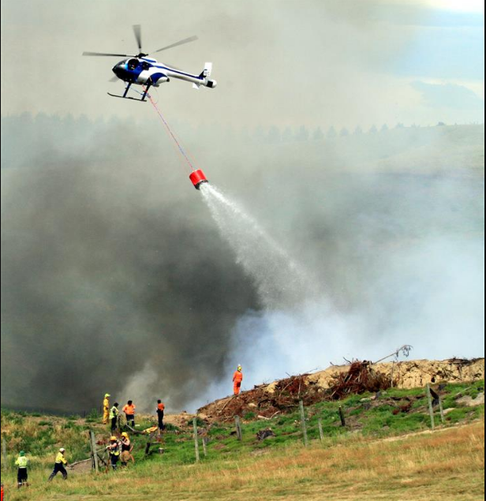
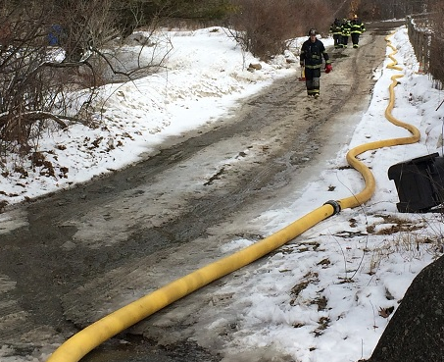
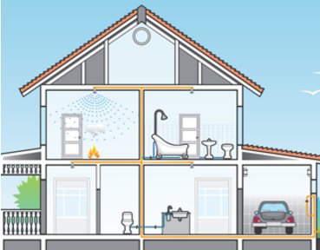
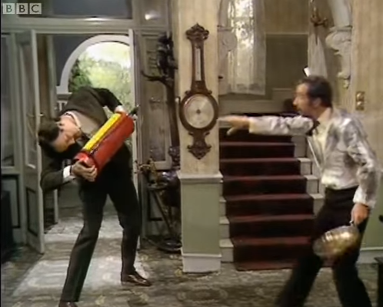
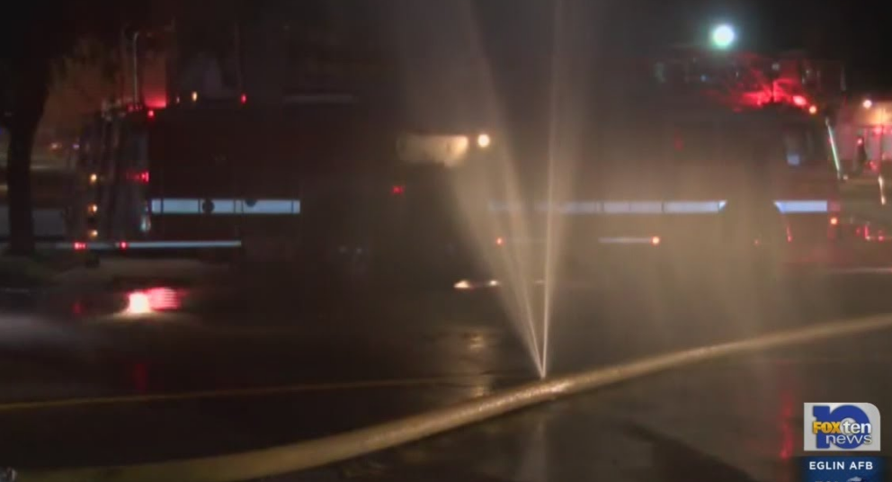
How do we use it?
Bucket
Fire extinguisher
Sprinklers
Hose
Monsoon Bucket.
Notes:
Buckets have been used in one form or another for millennia- first fire brigades in Rome used buckets- and still have their place when circumstances dictate.
Fire extinguishers- as long as you know how to use it before you need to
Sprinklers- the fire service strongly recommends sprinklers in all properties, especially houses, where a fire station is more than 10 minutes away. Sprinklers prevent a small fire from becoming a big fire, and therefore use much less water. Contrary to Hollywood, one sprinkler head going off does not set off every head in a building
Hose- we don’t want to run hose for long distances as it’s arduous and time consuming work, that comes with it’s own drawbacks (burst hose)
Monsoon bucket- we also used fixed wing in NZ. Hold around 1,500 litres.

Slide 5
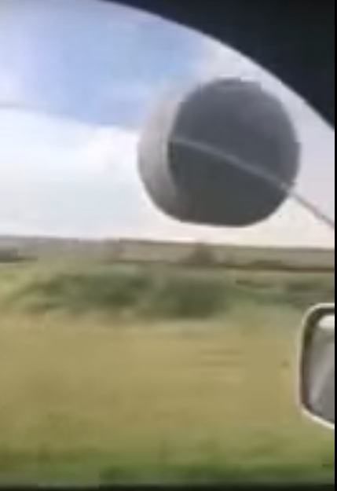
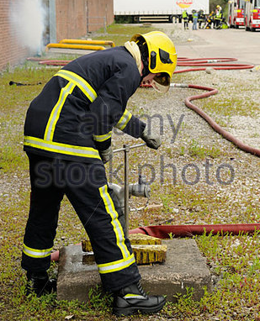
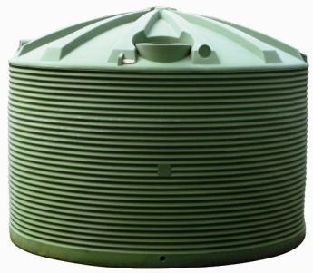
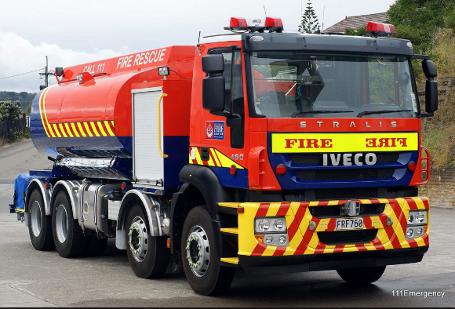
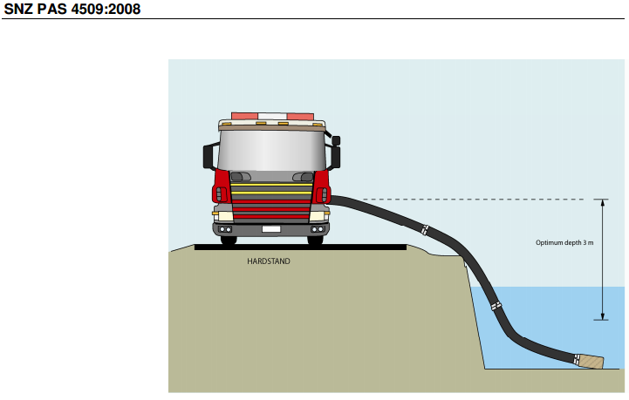
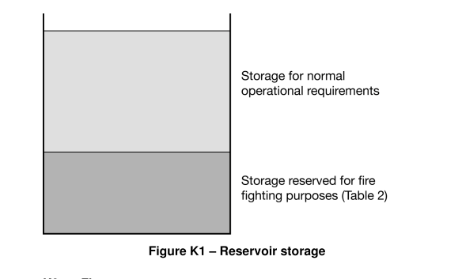
How we get it…
Appliance supplies
Reticulated supplies
Tank sources
Open water.
Notes:
Appliance supplies- 1300- 2000 litres on a pump- takes about 2 ½ minutes to empty when on a low pressure delivery, to 14000 litres in this case- about 17 ½ minutes to empty from one hose on full.
Reticulated supplies- we access them using a stand-pipe which allows us to attach hose
Tank sources- seen all around NZ, even travelling along rural Canterbury back roads! Important thing is to remember that we need to have reliable way of accessing the water, via a suitable fire service connection usually.
Open Water- hardstand: we need to be able to park safely without compromising personnel or equipment!
When we talk of tank sources we need to bear in mind that the water must always be available- this is done by taking off the water at different levels as per the picture…

Slide 6
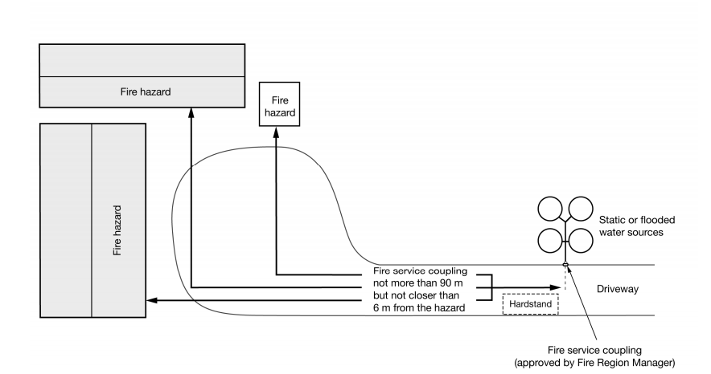
Challenges in getting it….
Access
Security
Visibility
Adequate Supply
Couplings.
Notes:
Suitable Access- ‘4m x 4m’ access (H by W) to within 90m, for a 20t vehicle: gradient, surface, turning circles, between 6m-90m from the hazard.
Security- against vandalism e.g. lightweight chain.
Visibility- signed where appropriate
Adequate Supply- 12.5 l/s or 750 l/min at the coupling
Couplings- so we can actually get the water!

Slide 7
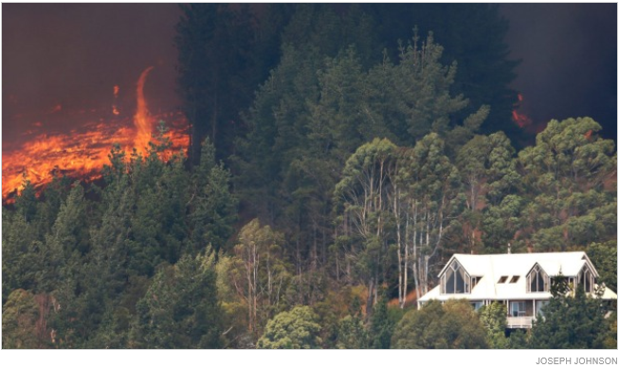
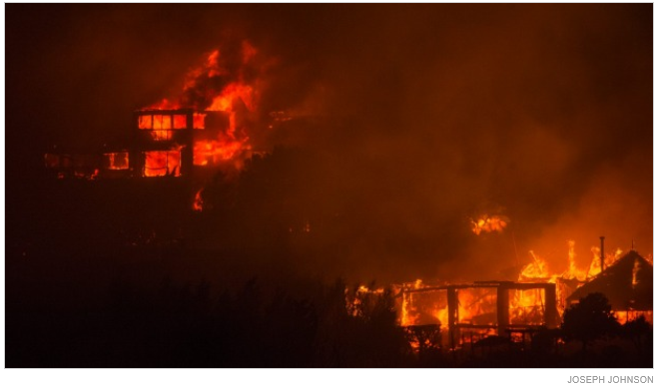
What happens if we don’t get it…..
Notes:
Unchecked fires have a habit of growing out of control- 11 homes were lost in the Christchurch Port Hills WITH the benefit of large numbers of personnel and ready water supplies. The conditions just conspired against us in this instance.

Slide 8
NZS 4509
Code of Practice for FFWS
Adoption under LA by-laws
Provides guidance- Appendix E
NZFS/Fire Emergency NZ guidance.
Notes:
It is non-mandatory unless adopted into Local Authority by-laws.
Appendix E gives step-by-step guidance on the a procedure and checklist for building consent documentation.
Volumes & flowrates
Distance from premises
Access width & height
Road gradients
Signage.
NZFS/Fire Emergency NZ guidance- we would rather be consulted early in a consent than later

Slide 9
FENZ
Fire and Emergency NZ
Proposed
Mandatory adoption of CoP
Must consult Local Authorities.
Notes:
It is important to look forward at this point to the introduction of FENZ, proposed to come in on 1st July 2017
Proposed- third reading: 14,15 March 2017
Mandatory adoption of CoP
Must consult Local Authorities

Slide 10
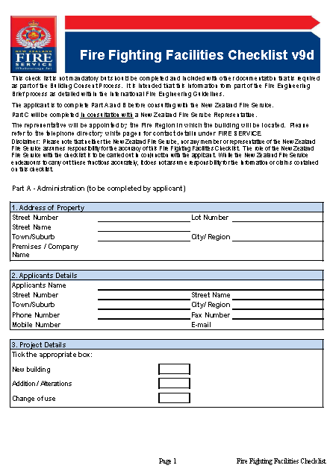
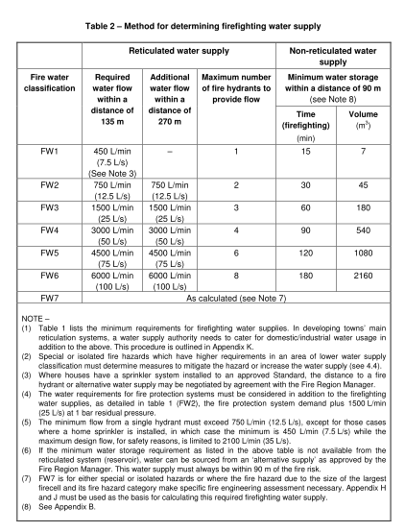
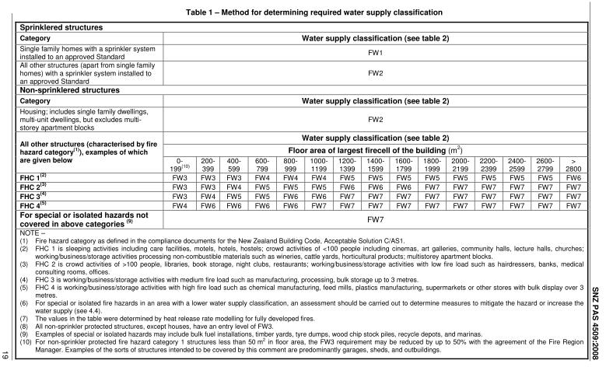
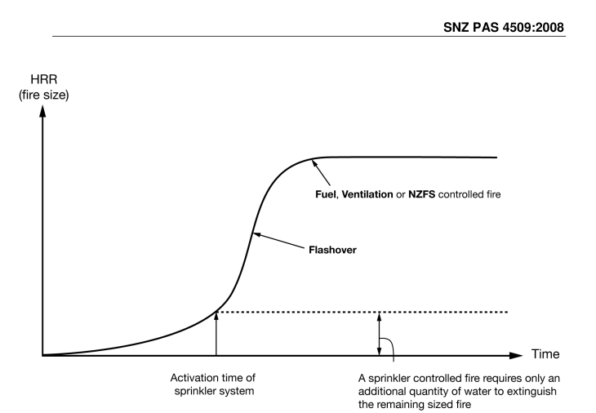
Options for water supply:
Tables (conservative figures)
Calculation (calculated for risk)
NZFS consultation (pragmatic approach)
Firefighting Facilities Checklist
Advice.
Notes:
Tables= conservative figures found by assessing the size of the fire-cell and the use of the premises, which gives an indication of the typical fire-loading for that type of premises.
Calculation=- calculated for the Risk
Consultation pragmatic approach
FFFC- required by Practice Note 22 for Fire Engineering Design. Provides us a way of ensuring water has been considered at the earliest stage.
General Advice

Slide 11
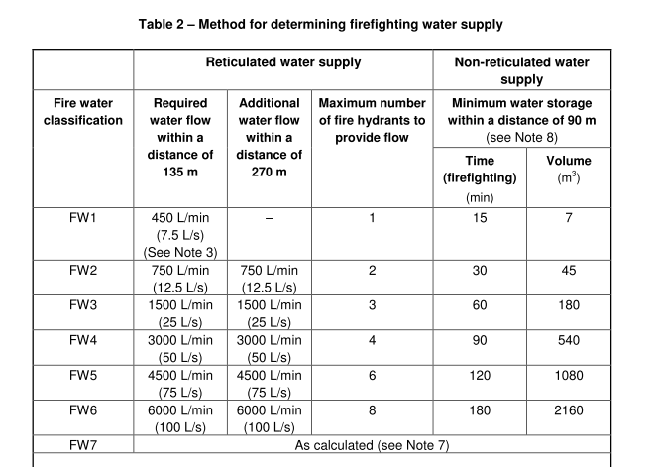
Options for water supply:
Tables vs. Calculation
Notes:
Tables= conservative figures found by assessing the size of the fire-cell and the use of the premises, which gives an indication of the typical fire-loading for that type of premises.
Calculation=- calculated for the Risk
It’s worth taking a look at the difference in the volumes…
Sprinklered domestic dwelling= 7m³ vs. non-sprinklered = 45m³
We can see the disparity in volumes straight away.
Similarly when we do the calculations as per the calculated method, for other groups we have seen sprinklered firecells drop from the ultra conservative 45m³ to 15m³

Slide 12
Firefighting Water
Why is water important?
How do we use it?
How do we get it?
Challenges
Code of Practice.
Notes:
Hopefully now we are all across the key points
Why water is important to the fire service
how the fire service uses water,
how we get it, and
some of the challenges we face in getting it to where we need it, and
And have a better understanding of the CoP and how we can give you advice on it, and what is coming in the future.

Slide 13
Questions?

